Slide 1
CONTENTS
INTRODUCTION
INPUT DEVICES
OUTPUT DEVICES
SMPS
MOTHERBOARD
CPU
MEMORY
CONCLUSION

Slide 2
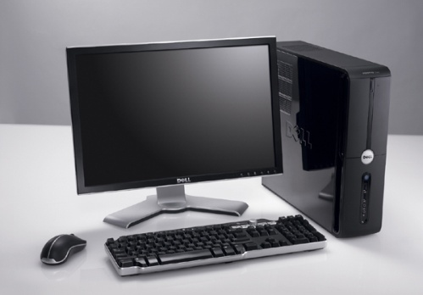
WHAT IS A COMPUTER ?
A Computer is programmable machine. This means it can execute a programmed list of instructions and respond to new instructions that is given
HARDWARE:
Hardware refers to the physical elements of a computer. This is also
sometime called the machinery or the equipment of the computer.
SOFTWARE:
Software is any set of instructions that tells the hardware what to do and how to do it.

Slide 3
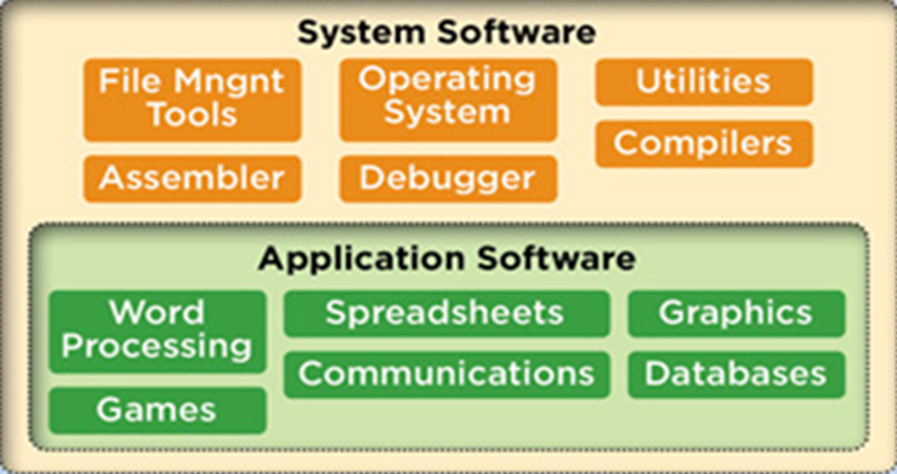
Types of Software:
1.System Software:
System software is computer software designed to provide a platform to
other software.
2.Application Software:
An application is any program, or group of programs, that is designed for the end user.

Slide 4
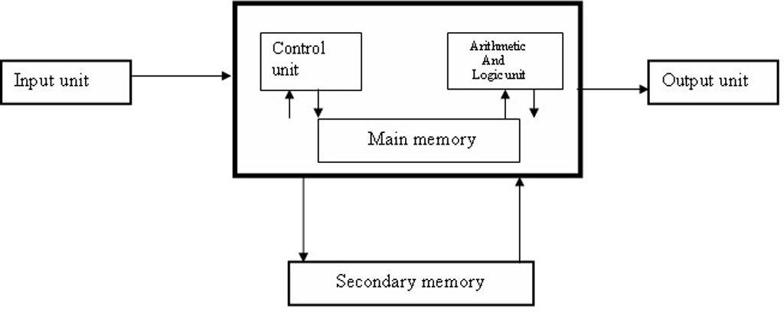
BLOCK DIAGRAM OF A COMPUTER

Slide 5
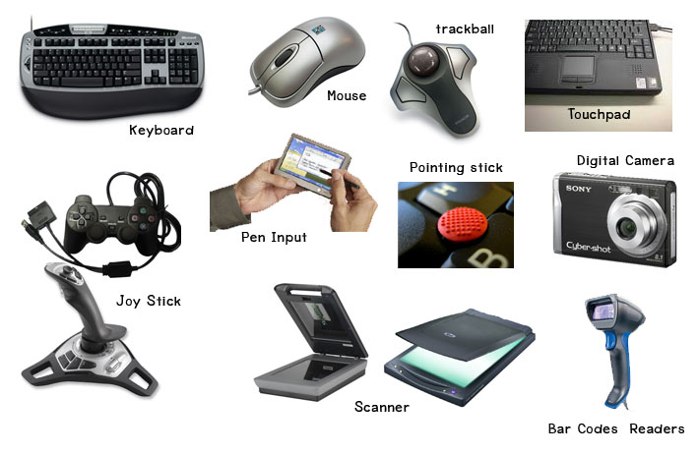
INPUT AND OUTPUT DEVICES
Input Devices:

Slide 6
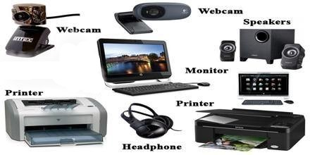
Output Devices:

Slide 7
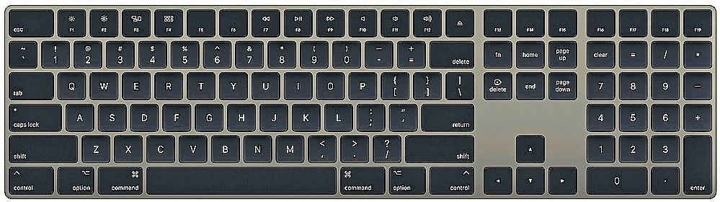
KEYBOARD
The keyboard is the piece of computer hardware used to input text,
characters, and other commands into a computer or similar device.
A keyboard is defined as the set of typewriter-like keys that enables
you to enter data into a computer or other devices.

Slide 8
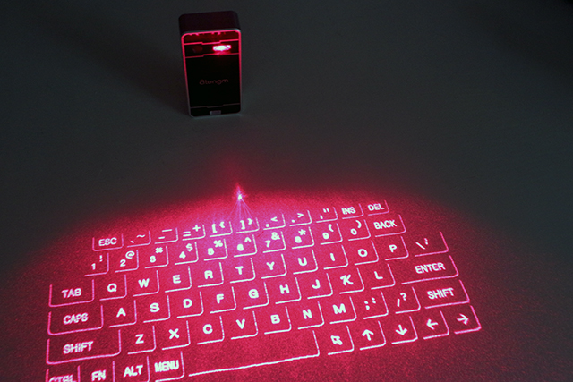
Virtual Keyboard:
A virtual keyboard is a projection keyboard that is projected
on any flat surface.
Virtual keyboard uses sensor technology and Artificial Intelligence
to let user works on plane surface.
Whenever we press the keyboard button,
then optical device detects the stoke
and sent it to the computer.

Slide 9
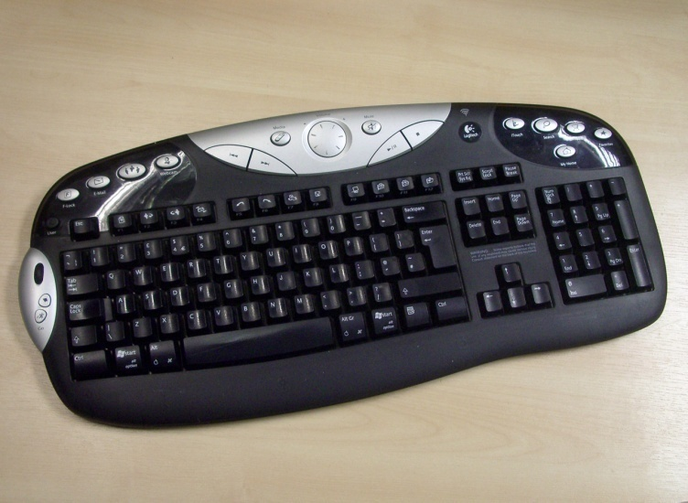
Multimedia Keyboard:
A Multimedia keyboard is one with media keys, additional buttons on
the top, for controlling audio playback and for starting common applications
(e.g. e-mail client and Web browser) and other auxiliary functionality.
Many such keyboards also contain a volume knob,
implemented as a rotary encoder so as to be
able to provide relative volume changes.

Slide 10
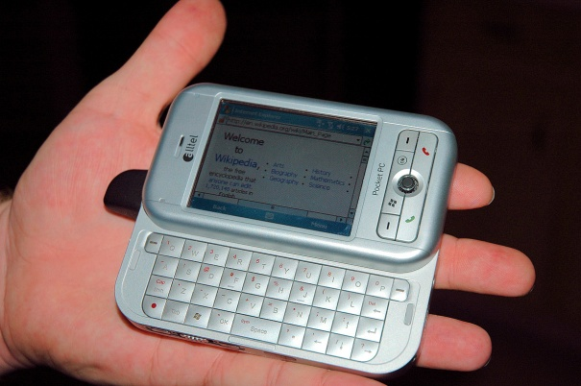
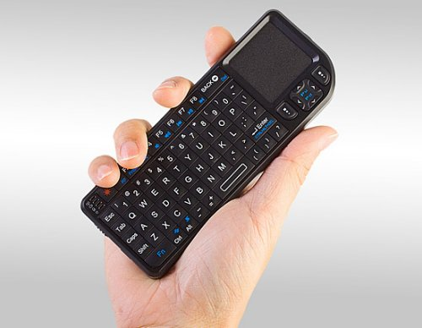
Thumb Keyboard:
A thumb keyboard, or a thumb board, is a type of
keyboard commonly found on PDAs, mobile
phones, and PDA phones which has a familiar
layout to an ordinary keyboard, such as QWERTY.
The inputting surface is usually relatively small,
and is intended for typing using the available
thumbs, while holding the device.

Slide 11
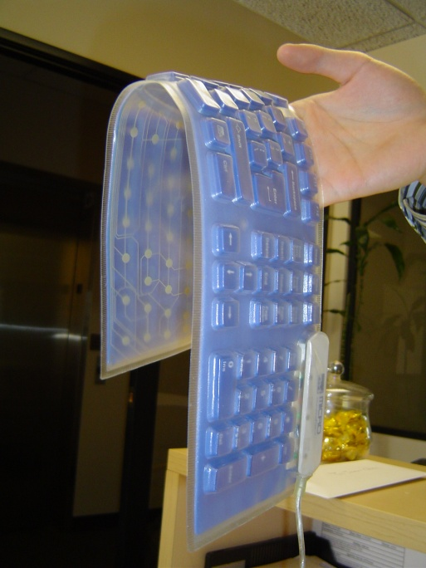
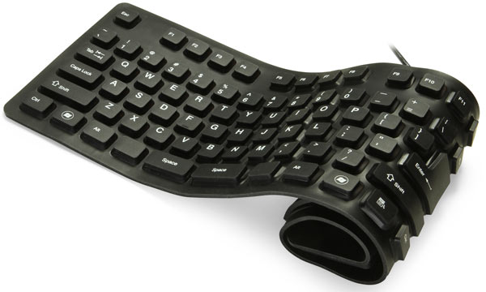
Roll-Up Keyboard:
Keyboards made of flexible silicone or polyurethane materials
can roll up in a moderately tight bundle.
Tightly folding the keyboard may damage the internal
membrane circuits. When they are completely sealed
in rubber they are water resistant.

Slide 12
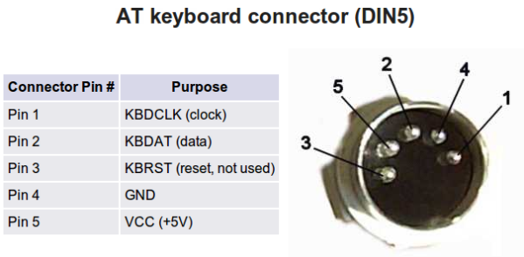
Types of Connectors
AT Keyboard Connector (DIN 5):
The 5-pin DIN (Deutsches Institut für Normung) connector was the first
widespread non-proprietary keyboard cable connector.
It was a bit larger than today's connectors, and had five pins which were
oriented asymmetrically to ensure a proper connection.

Slide 13
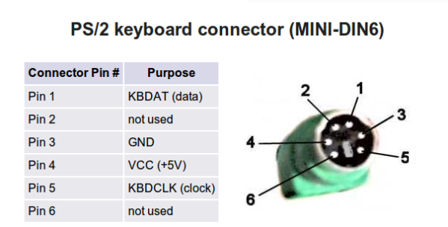
PS/2 Keyboard Connector (MINI-DIN6):
The 6-pin mini-DIN connector is a replacement for the original 5-Pin design.
This type of connector is often referred to as a PS/2 connector and is also
named for the IBM system that popularized it. This format is widely used
in desktop computers.

Slide 14
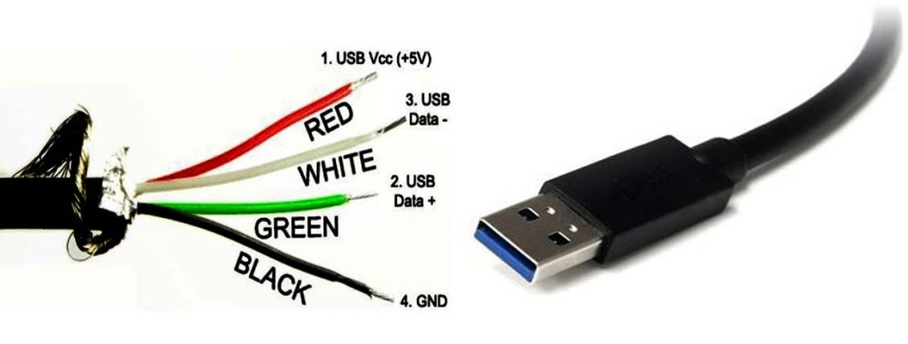
USB:
USB is an extremely common keyboard cable connector type.
This small rectangular connector provides a major upgrade over the DIN
connector types.
AT and PS/2 devices are not hot-swappable.

Slide 15
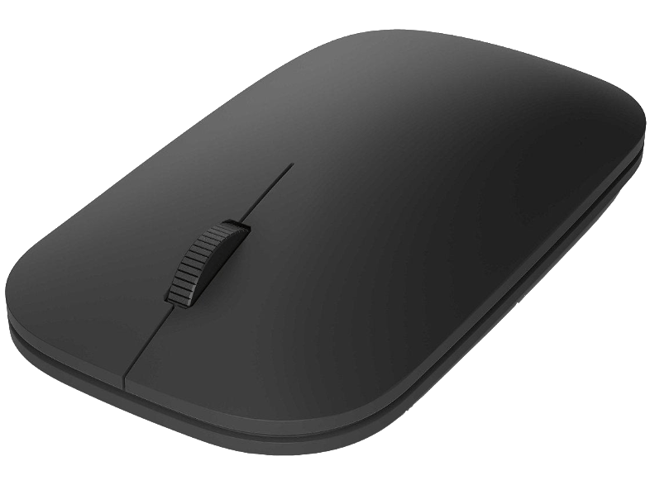
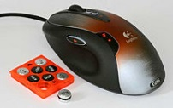
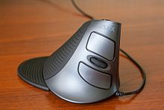
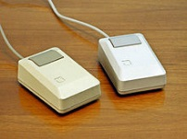
MOUSE
A computer mouse is a hand-held pointing device that detects
two-dimensional motion relative to a surface. This motion is typically
translated into the motion of a pointer on a display, which allows a
smooth control of the graphical user interface.
The mouse was originally known as the X-Y Position Indicator
for a Display System and was invented by Douglas Engelbart
in 1963 while working at Xerox PARC.

Slide 16
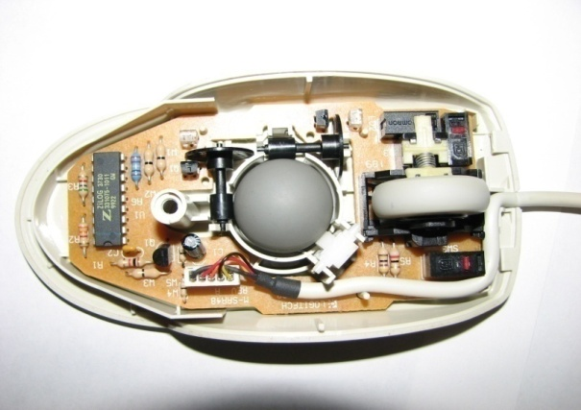
MOUSE TYPES
Mechanical Mouse
Bill English created a ball mouse in 1972
The ball mouse replaced the external wheels with a single ball that could rotate in any direction

Slide 17
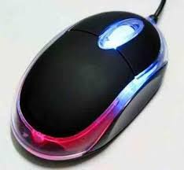
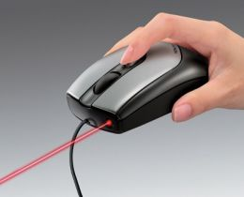
Optical Mouse :
An optical mouse was developed in around 1980
Optical mouse make use of one or more light-emitting diodes (LEDs) and
an photodiodes to detect movement relative to the underlying surface
It is unable to detect movement on surfaces like glass

Slide 18
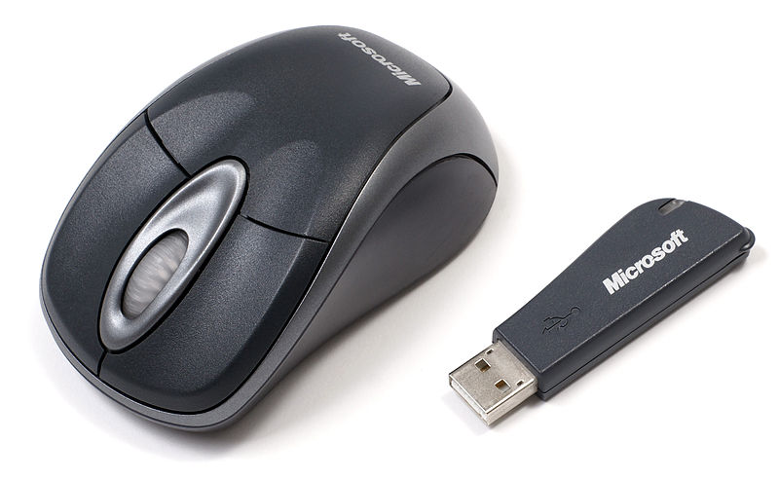
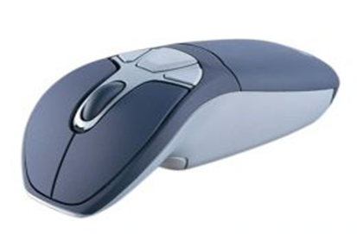
Wireless Mouse
Wireless Mouse does not consist of any cords to connect mouse to the PC
Cordless or wireless mouse transmit data via infrared radiation or Bluetooth
signals
This consist of Transmitter and Receiver part connected trough wirelessly

Slide 19
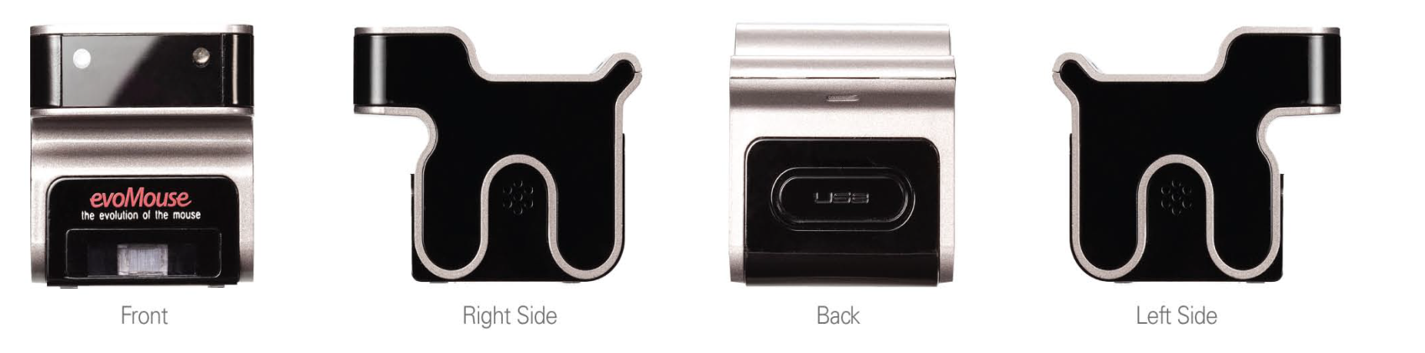
Evo Mouse
The Evo Mouse is the evolution of the computer mouse.
Evo Mouse is a dog – shaped device that functions differently and not like
the other mouse

Slide 20
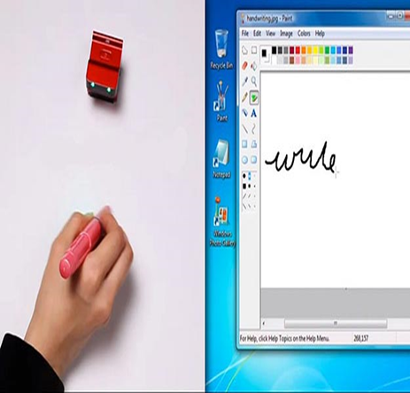
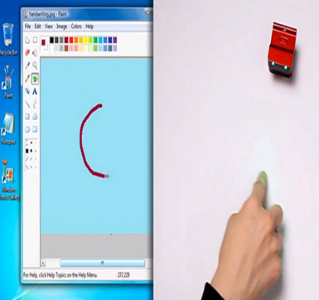
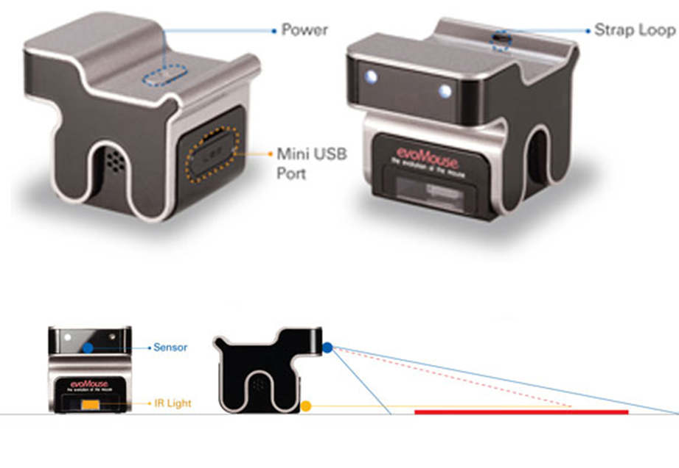
WORKING:

Slide 21
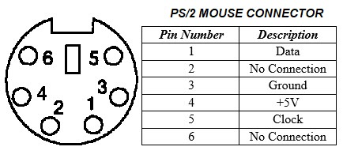
Types of Connectors
PS/2 Connector:

Slide 22
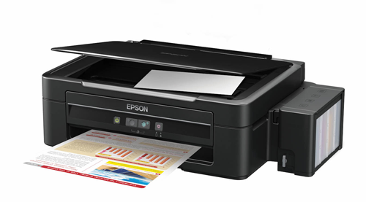
SCANNER
A scanner is a device that captures images from photographic prints,
posters, magazine pages, and similar sources for computer editing and display.
Very high resolution scanners are used for scanning for high-resolution printing,
but lower resolution scanners are adequate for capturing images for computer display.
Scanners usually come with software, such as
Adobe's Photoshop product, that lets you resize
and otherwise modify a captured image.

Slide 23
Scanning Formats:
Depending on your scanning software, you may have different options
of file formats in which to save your scanned image or document.
Images may be saved as: jpg, bmp, tif, or png.
Documents may be saved as: pdf, or any of the image formats.

Slide 24
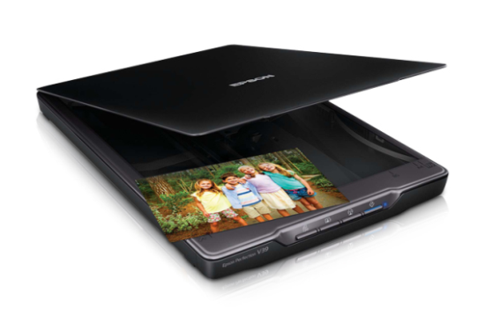
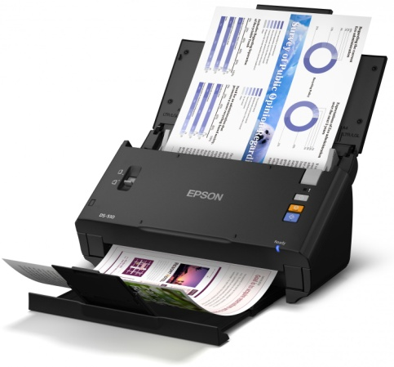
SCANNER TYPES
Flatbed Scanner:
A flatbed scanner is an optical scanner which makes
use of a flat surface for scanning documents. The scanner is
capable of capturing all elements on the document and
does not require movement of the document.
Sheetfed Scanner:
As its name suggests, in this type of scanner,
the document is fed into the horizontal or vertical slot provided
in it. While the sensor and source of light are stationary. Instead,
the document moves through the scanner. These scanners cannot
scan thick objects, like books.

Slide 25
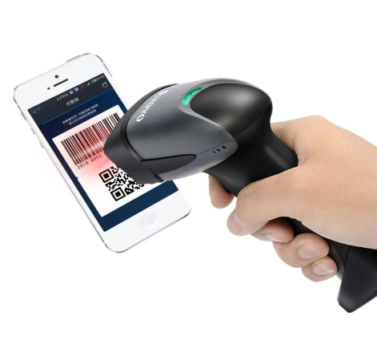
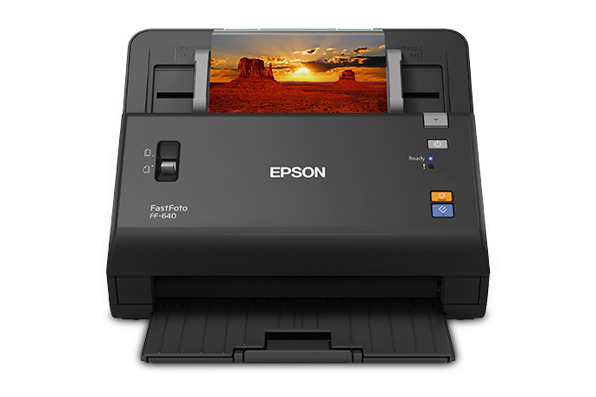
Hand-held Scanner:
A handheld scanner is a small manual scanning device
which is moved over the object that needs to be scanned. Even a slight
movement of hand can lead to distortion of the image. Hand held
scanners are generally used with bar code technologies like library
systems in schools.
Photo Scanner:
As the name itself suggests, a photo scanner is
mostly used to scan photographs. It boasts of high
resolution and color depth, both of which are necessary
for scanning photographs.

Slide 26
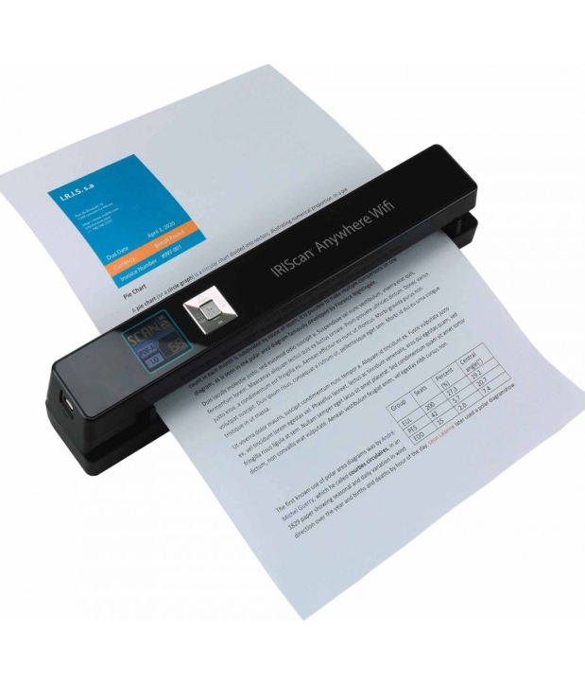
Portable Scanners:
Being small in size, portable scanners can be easily carried around.
They are of great help when it comes to text document scanning. Their
drawback though, is their limitation in terms of resolution.

